Slide 1
CAPSTONE PROJECT

Slide 2
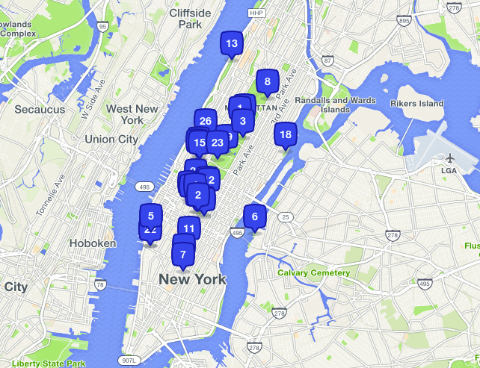
Restaurant Recommender System

Slide 3
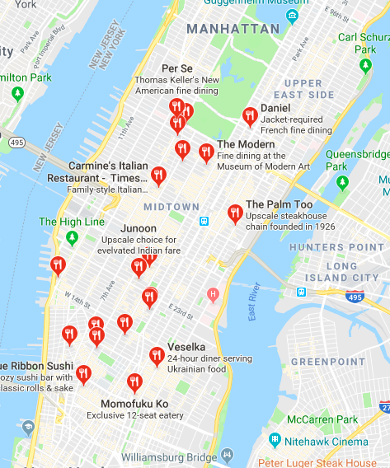
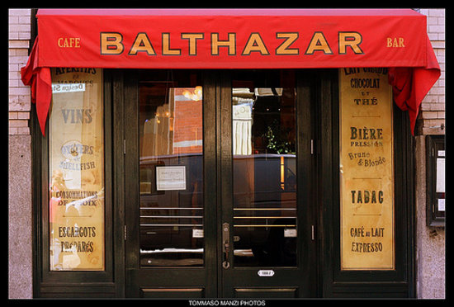

Overview
A system to suggest the top Restaurants in Manhattan to an user based on the Restaurants liked/tipped by the user in the past.
Approach
Create similar clusters of Restaurants in Manhattan based on the category of the Restaurant and popularity of the Restaurant(other features like price, rating and tips can be used for more accuracy)
Analyse the Restaurants visited or tipped by the user in the past
Recommend Popular Restaurants in Manhattan

Slide 4




Methodology
Data Extraction : Used Foursquare API and New York Location Data to explore all the restaurants in Manhattan
Data Preparation
Created a data table containing Restaurant details Like name, id, lat, lon, number of likes, category.
Stored user visited restaurant details in one more data table
Modelling
Used Elbow Method to find the optimal k for k means clustering.
Clustered all the restaurants in Manhattan using k means clustering.
Recommendation
Analysed the top category of restaurant visited by the user in the past.
Recommended Restaurant of similar category from the cluster of restaurants with most popularity.

Slide 5
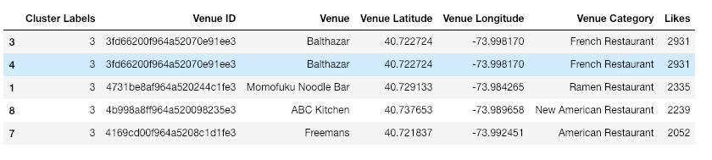
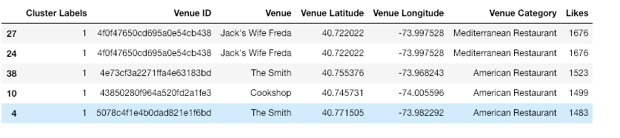
Results
Cluster 4 (Most Popular : Recommendations for User)
Cluster 2 (Moderately Popular : Will Come in Recommendations once Most Popular is Exhausted)

Slide 6

Conclusion
In this study, I analysed the different clusters of restaurants present in Manhattan based on the Restaurant Category and number of likes(popularity) received by the venue. More features such as ratings and cost of a Restaurant could have been used to have more accurate recommendations.
After the Clusters are formed, I built an user profile by analysing the most visited Restaurants of the user and matched the same with the clusters of Manhattan.
A recommendation from the cluster is done based on the most popular category of Restaurant visited by the user.

